Slide 1

CLINIC WAIT-TIME
ANALYSIS
DATA SCIENCE & ANALYTICS INTERNSHIP
Presentation by: Group 2a
Date: 31st October, 2026
Notes:
Introduce the group and the project. The one-line answer we will build towards: waits are about 106 minutes in every department, visit type and month, so the problem is clinic-wide. The screenshot is the finished dashboard we will demo live.

Slide 2

PRESENTATION OUTLINE
1
Introduction and background
The question and who needs the answer
2
Data exploration and data quality
Four tables and six hidden problems
3
Data cleaning and preparation
How we fixed each problem and why
4
Data modelling and measures
A star schema, with every measure checked in SQL
5
Power BI dashboard
One page built for the clinic administrator
6
Key findings
Departments, visit types, months and the spread of waits
7
Challenges, Conclusions and Recommendations
The answer, what it means, and what to do next
Notes:
A quick roadmap of the next ten minutes. The talk follows the project: question, data, cleaning, model and measures, dashboard, findings, and what it means for the clinic. Questions come at the end.

Slide 3
INTRODUCTION AND BACKGROUND
Patient waiting time is an important aspect of healthcare service delivery. Long waiting periods can affect patient satisfaction and the overall efficiency of healthcare facilities. Staff views differed about which department had the longest waits, so we used visit records to examine the pattern.
THE PROBLEM
OUR AIM
WHO NEEDS THE ANSWER?
Which departments have the longest patient wait times, and how does that vary by visit type and over time?
Use evidence to identify where waiting is concentrated or determine whether it is clinic-wide.
The clinic administrator, who needs clear findings to guide service-improvement decisions.
25,100
900
8
Jan 2024 – Dec 2025
Raw visit records
Patients
Departments
Study period

Slide 4






DATA EXPLORATION AND DATA QUALITY ASSESSMENT
25,100
900
40
8
Visits (fact table)
Patients
Doctors
Departments
100
12 to 3
4
duplicate visits
visit-type spellings
date formats
Exact copies sharing a visit ID
Mixed case and stray spaces split 3 categories
Stored as text, so the date range made no sense
51
62
1,508
negative waits
unmatched patient IDs
visits with no visit type
Waits range from -209 to 209 minutes
A plain join would drop them silently
About 6% of all rows
Notes:
We found all six planted problems with SQL before touching anything: duplicates, inconsistent categories, dates in four formats stored as text, impossible negative waits, orphan patient IDs, and missing visit types. The numbers are on the cards.

Slide 5
DATA CLEANING AND PREPARATION
Problem | What we did | Why
Duplicate visits | Kept the first copy of each | Exact copies would double-count visits
Spelling variants | Trimmed spaces, standardised case | One category means one bar in every chart
Missing visit type | Labelled "Unknown", rows kept | Their waits are still valid data
Four date formats | Parsed into real dates, day first | Needed for any trend over time
Negative waits | Set to blank, rows kept | Cannot be real and the true value is unknowable
Unmatched patient IDs | Pointed at an "Unknown" patient | Keeps every visit in the totals
25,100 raw visits
- 100 duplicates removed
= 25,000 clean visits
Notes:
Every decision has a reason. The row arithmetic adds up exactly: 25,100 raw visits minus 100 duplicates gives 25,000 clean visits. We did not drop anything for impossible values or unmatched patient IDs.

Slide 6
Data Cleaning Decisions and Justifications
Dates read day first
Negative waits left blank
DD/MM/YYYY, not MM/DD/YYYY
Not flipped, not dropped
Proof: dates such as 29/07/2024 and 26/07/2025 have a first number above 12, so it can only be the day.
We looked for a pattern: they spread across all 8 departments and nearly every month.
Check: each of the four formats matched a strict parse on every row.
With no pattern, any "corrected" value would be invented, so the wait is blank.
If we were wrong, 535 rows (2.1%) would land in the wrong month.
The rest of each row (department, type, date) is still valid and stays in.
Notes:
Be ready for the question: why did you clean it that way. Dates: the proof is the rows where the first number exceeds 12. Negative waits: we checked for a pattern before choosing, and found none.

Slide 7
DATA MODELLING: BUILDING THE STAR SCHEMA
Patients
901 rows (900 + Unknown)
one row = one patient
Departments
Visits
DateTable
8 rows
25,000 rows
731 days
one row = one department
one row = one patient visit
built by us, marked as date table
Doctors
40 rows
one row = one doctor
Notes:
One fact table in the middle with the dimensions around it, and a date table we built ourselves. Doctors hangs off departments because Power BI refused a second active path between visits and doctors. Our question does not need doctor-level detail.

Slide 8

MEASURE DEVELOPMENT AND SQL VALIDATION
Measure | Power BI | SQL | Match
Average Wait | 106.32 | 106.32 | Yes
Median Wait | 106.00 | 106.0 | Yes
Visits | 25,000 | 25,000 | Yes
% Emergency Visits | 14.45% | 14.45 | Yes
Fee Revenue | 755,945 | 755,945 | Yes
5 of 5
measures match the database
Total wait time was 2,652,563 in both Power BI and SQL, and the eight department totals matched row for row.
Notes:
Every headline measure was checked against a SQL query. The percentage looked wrong at first (0.14 against 14.45) because it was formatted as a decimal, not because the DAX was wrong. After changing the format all five matched.

Slide 9
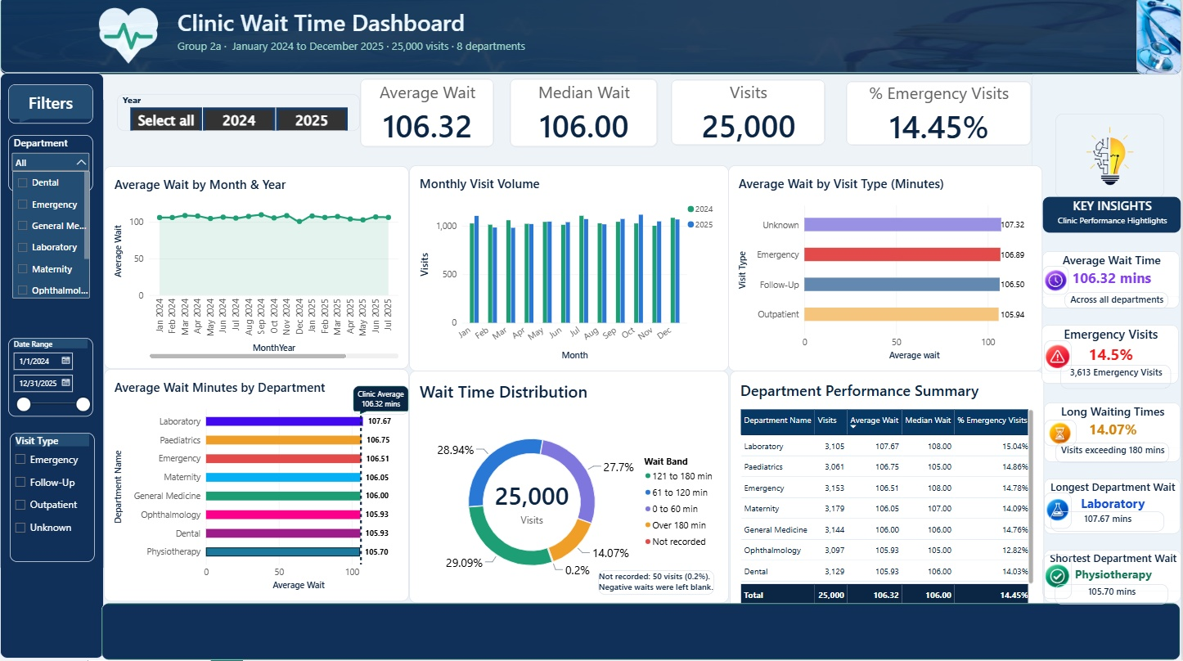
Power BI Dashboard Development and Interactivity
Notes:
This is the point to switch to the live dashboard. Click the Year slicer and the Visit Type slicer and show that every visual changes. Click a department bar to show filtering, and clear it afterwards. The key insights panel on the right summarises the main figures.

Slide 10
KEY FINDINGS
1. Departmental Waiting-Time Analysis
106.32 min
clinic average across all 25,000 visits
2.0 min
gap between Laboratory (107.7) and Physiotherapy (105.7)
Notes:
Staff believed some departments were clearly worse. The data says otherwise: all eight sit between 105.7 and 107.7 minutes. We kept the axis at zero on purpose so a 2-minute gap is not exaggerated.

Slide 11
2. Waiting-Time Trends Across Visit Types and Months
Emergency patients wait 106.9 minutes, about the same as Follow-up (106.5)
Monthly averages stay between 100.6 and 109.8, with no upward or downward trend
Notes:
Two more halves of the question. By visit type: emergency patients wait as long as routine patients, which is not what you would expect. Over time: the line stays flat across both years. Unknown is the 1,500 visits with no recorded visit type.

Slide 12
3. Understanding Waiting-Time Distribution
0 to 60 min
27.7%
61 to 120 min
28.9%
121 to 180 min
29.1%
25,000
Over 180 min
14.1%
visits
Not recorded
0.2%
About 1 in 7 visits waited more than 3 hours and only 28% waited an hour or less.
Notes:
The averages look calm, but individual waits are spread almost evenly from a few minutes to over three hours. That matters more to a patient than the average. The thin grey slice is the 50 impossible negative waits we blanked.

Slide 13
ANSWERING THE QUESTION
SUB-QUESTION | ANSWERS
Which departments wait longest and by how much? | Laboratory at 107.7 minutes, but only 2.0 minutes above Physiotherapy (105.7). No department stands out.
Do emergency visits wait less than routine ones? | No. Emergency waits 106.9 minutes, Outpatient 105.9 and Follow-up 106.5.
Are waits getting better or worse over time? | Neither. Monthly averages stay between 100.6 and 109.8 in both years.
How are individual waits spread? | Widely. 14.1% of visits waited over 3 hours and 27.7% waited an hour or less.
Decision for the administrator: do not single out one department. Treat waiting as a clinic-wide process issue and target the long waits.
Notes:
This slide states the answer directly, one line per sub-question, and ends with the decision the administrator would now make. Match the sub-question wording to the week 1 scope note if it differs.

Slide 14
CHALLENGES
WHAT WENT WRONG | WHAT IT TAUGHT US
A stray column named COLUMN reached the database | Placeholder code ran before it was edited. List a table's columns after writing it.
The Year slicer returned blank | The date and the calendar did not match, most likely a hidden time part. A clean Visit Day column fixed the link.
Cards showed one department's numbers | A selected bar was filtering the whole page. Always check what is highlighted.
Power BI refused the doctors link | Two active paths between two tables are not allowed, so it stays inactive.
Notes:
Honest accounts of what went wrong tend to score well in Q&A. Each of these was found by checking numbers, not by luck.

Slide 15

CONCLUSION & LIMITATION
No single department is the problem. Waiting affects the whole clinic.
The data shows where waits happen, not why. Explaining why needs staffing and patient-flow data.
Notes:
The answer for the administrator: do not single out one department, because the data does not support it. Treat waiting as a clinic-wide issue and target the long waits. Recommendation 3 comes straight from our data quality findings: 1,508 visits had no visit type and 51 had impossible negative waits.

Slide 16
RECOMMENDATIONS
Treat waiting as a clinic-wide process issue: review scheduling and patient flow in every department.
1
Track the long waits: report the share of visits over 3 hours each month, not just the average.
2
Fix recording at the source: capture visit type on every visit and block negative wait times.
3
Notes:
The answer for the administrator: do not single out one department, because the data does not support it. Treat waiting as a clinic-wide issue and target the long waits. Recommendation 3 comes straight from our data quality findings: 1,508 visits had no visit type and 51 had impossible negative waits.

Slide 17
REPOSITORY AND REPRODUCIBILITY
1
Run the notebook top to bottom. It reads the raw schema and writes four clean tables to our own schema.
Data-Science-Internship-Group-2a-Clinic-Visits/
README.md
question, approach, findings
scope.md
question and scope
Open the .pbix. It reads those clean tables from the database, not from exported files.
2
data_quality_notes.md
what we found wrong
sql/
profiling and check queries
notebooks/
cleaning notebook
3
Re-run the queries in sql/ to check any figure on the dashboard.
dashboard/
Power BI file
presentation/
these slides
Notes:
Judges read the repository before the demo. Anyone should be able to rebuild our work from it. Check before presenting that no password appears anywhere in the notebook or the git history.

Slide 18
THANK YOU
GROUP 2A
Notes:
Thank the audience and invite questions. Expect: why did you clean it that way, why that model, what surprised you, what would you do next. The appendix slides have the answers ready.

